Slide 1

[SCHOOL NAME]

Slide 2
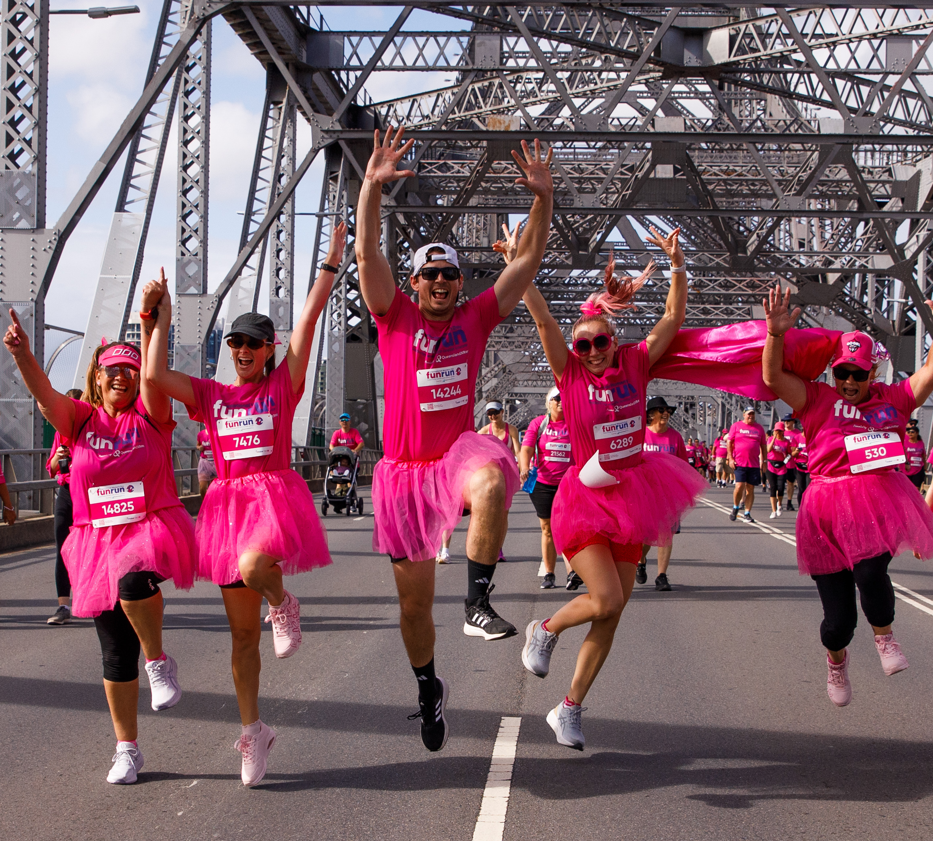

International Women’s Day Fun Run
What: International Women’s Day Fun Run, an iconic fundraising event hosted by Mater Foundation.
Join the sea of pink from South Brisbane, Kangaroo Point to Brisbane CBD to support women with breast cancer.
When: Sunday 8 March, 2026
Where: Mater Private Hospital, South Brisbane
Notes:
The International Women’s Day Fun Run is our iconic fundraising event hosted by Mater Foundation on Sunday 8th March 2026. Over 20,000 participants form the sea of pink, starting from Mater Private Hospital South Brisbane through to Kangaroo Point and the Brisbane CBD. By participating in the fun run, you’re raise vital funds and supporting women with breast cancer.

Slide 3


Our impact
Mater Chicks in Pink was created so that no woman would have to go through breast cancer alone.
Did you know?
people diagnosed with breast cancer
each year in Australia.*
1 in 7 women are diagnosed with breast cancer in their lifetime.*
1 in 4 breast cancer patients in Queensland treated at a Mater hospital.^
*National Breast Cancer Foundation (NBCF)
^Mater Health
Notes:
Mater Chicks in Pink by Mater Foundation was created with one simple mission: to make sure no woman ever has to face breast cancer alone.
Did you know?
Every year, over 20,000 people in Australia are diagnosed with breast cancer.
It’s the second most commonly diagnosed cancer in the country.
And for women, the reality is stark, 1 in 7 will be diagnosed with breast cancer in their lifetime.
Here in Queensland, one in every four breast cancer patients is treated at a Mater hospital.

Slide 4

Our impact
Your fundraising and support helps to fund:
Free, personalised and practical breast cancer support services.
Mastectomy bras to support confidence and healing after breast removal surgery.
Provide wigs or scarves to help women feel like themselves after chemotherapy-related hair loss.
Deliver health technology for rapid, life-saving testing and drive critical research and treatment advances for women with breast cancer.
Join us in the fight against breast cancer today!
Notes:
Your support helps women focus on what truly matters, the moments with their loved ones, while easing the emotional and financial burden that comes with a breast cancer diagnosis.
Every dollar you fundraise brings us closer to better treatments, better care, and better outcomes for women facing breast cancer.
You’re giving hope by:
Providing free, personalised support services that guide women through one of the toughest times in their lives.
You’re helping to supply mastectomy bras, wigs, and scarves—small things that make a big difference in restoring confidence and dignity.
You’re enabling access to advanced health technology and equipment, delivering rapid, potentially life-saving testing.
And you’re driving critical research and treatment breakthroughs, giving women the best chance at beating breast cancer.
So, by joining us in the Mater Chicks in Pink Fun Run you’ll be standing with us in supporting women with breast cancer.
Together, we can change lives, and create a future where no woman faces breast cancer alone.

Slide 5
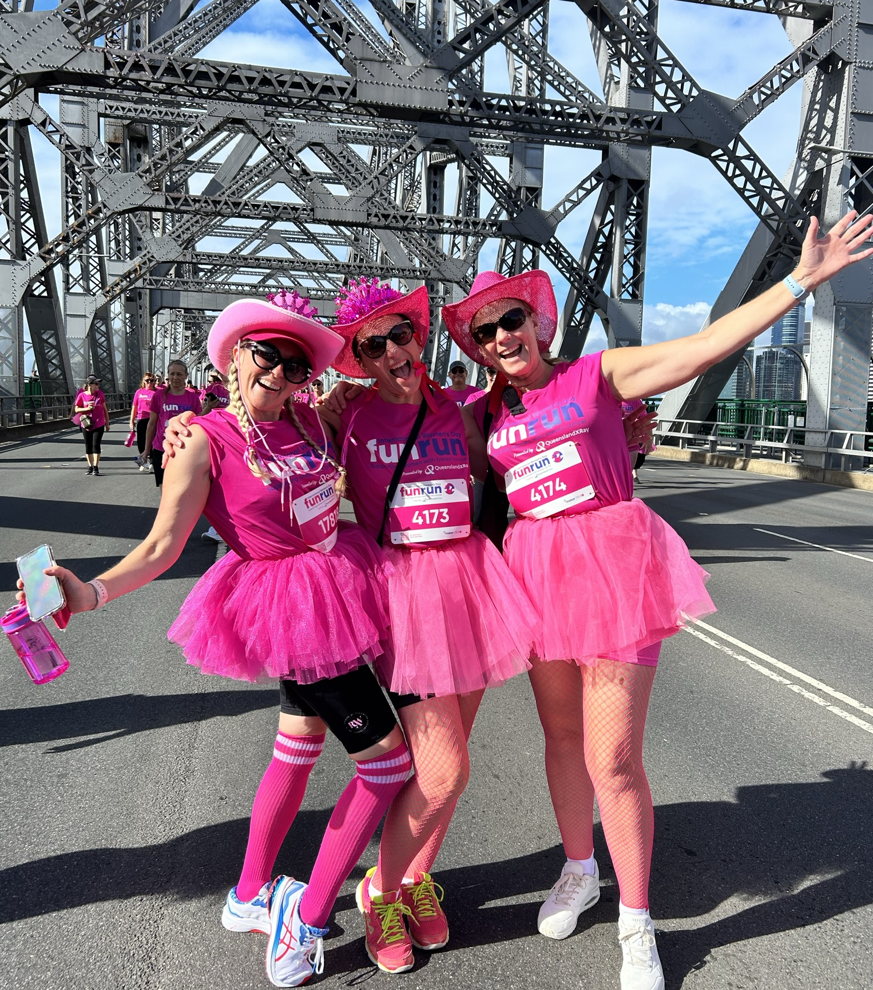
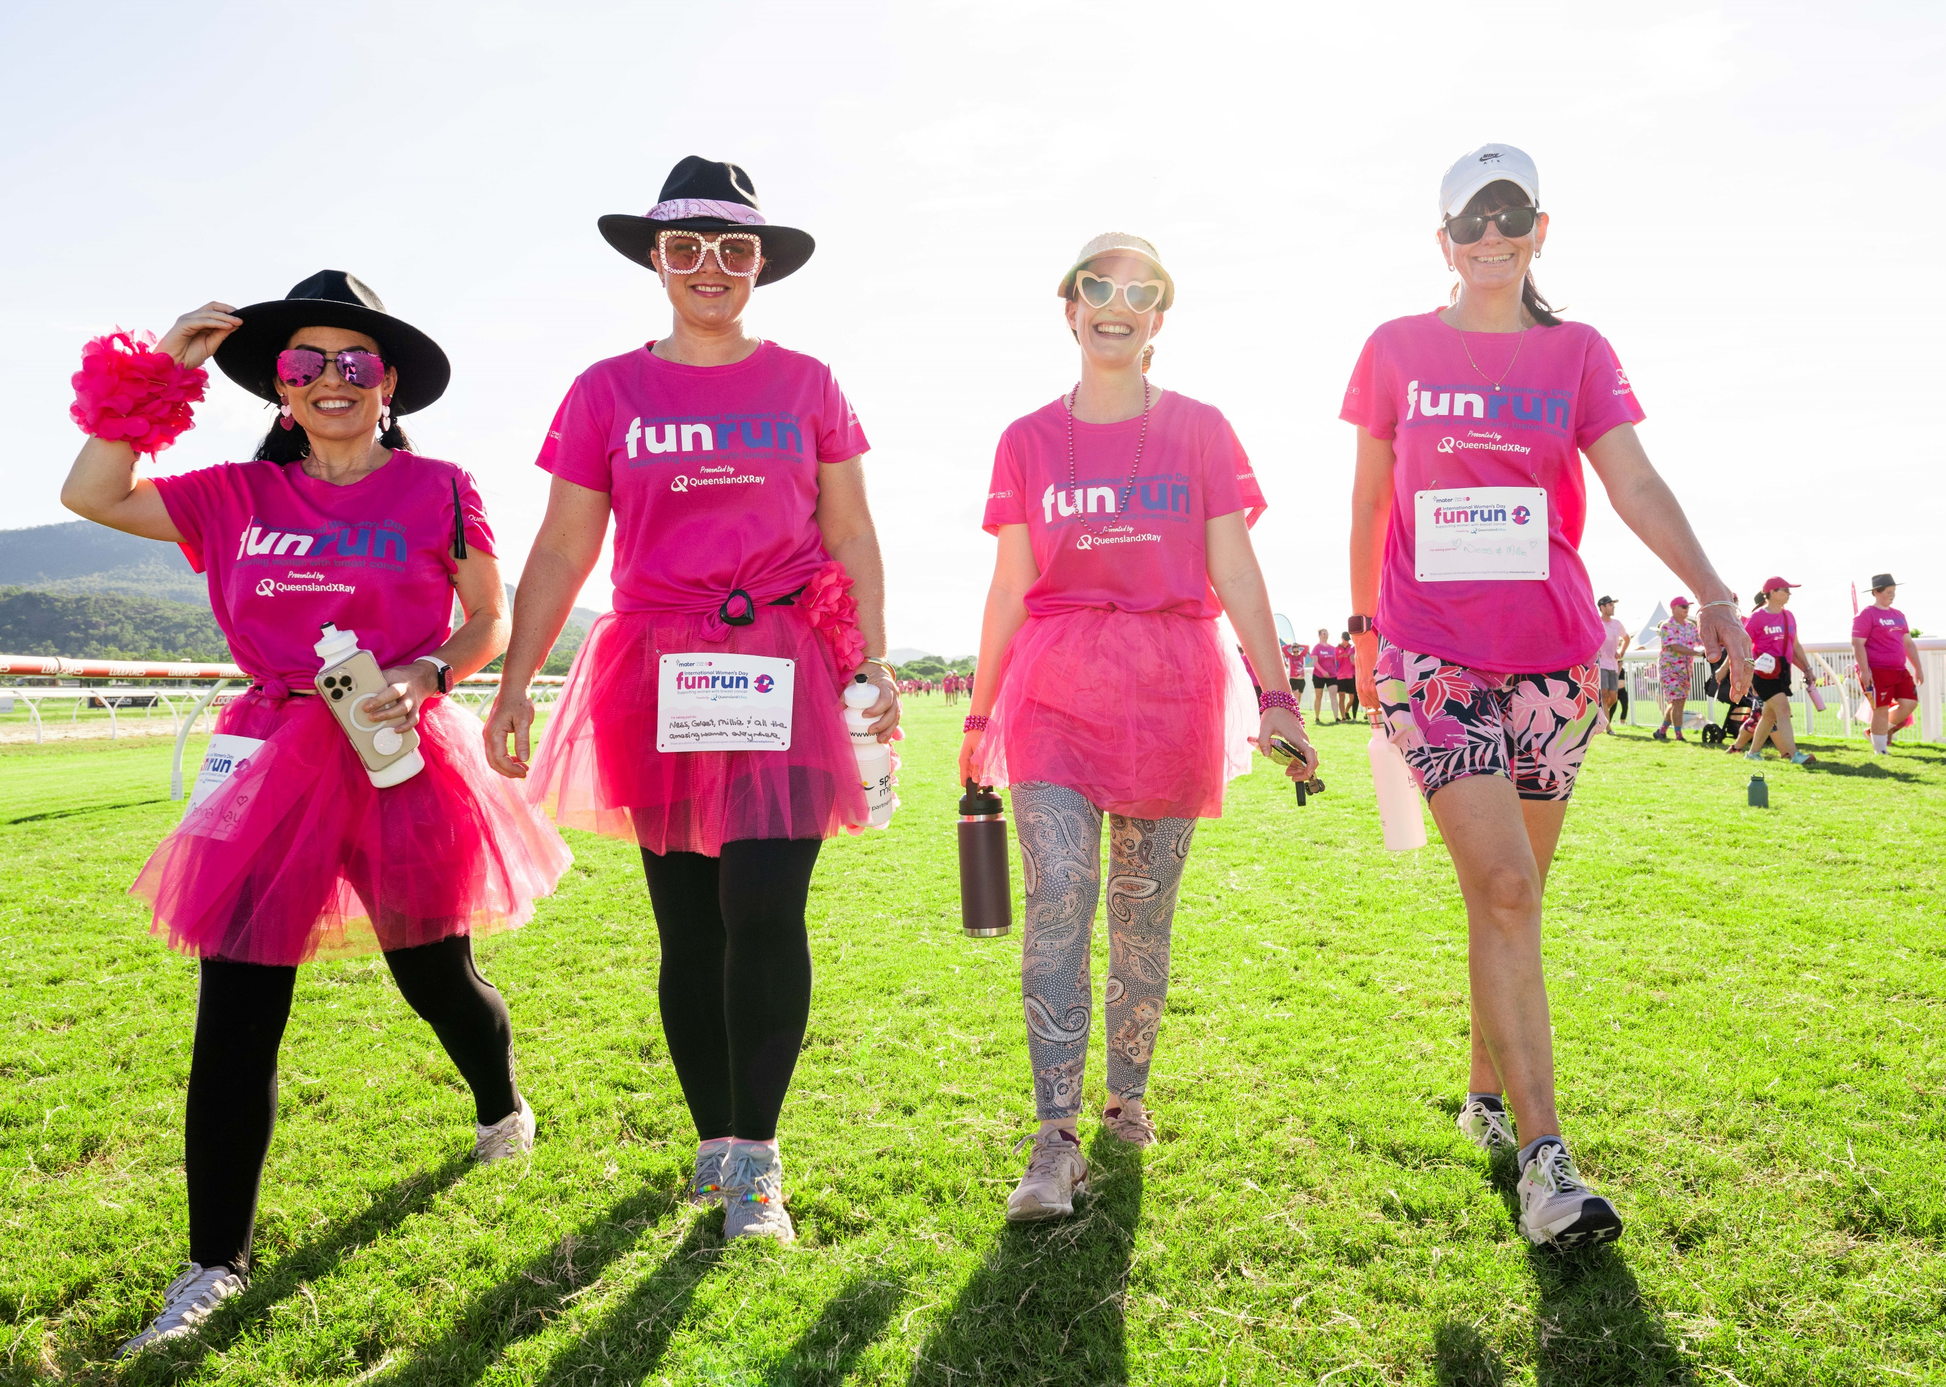
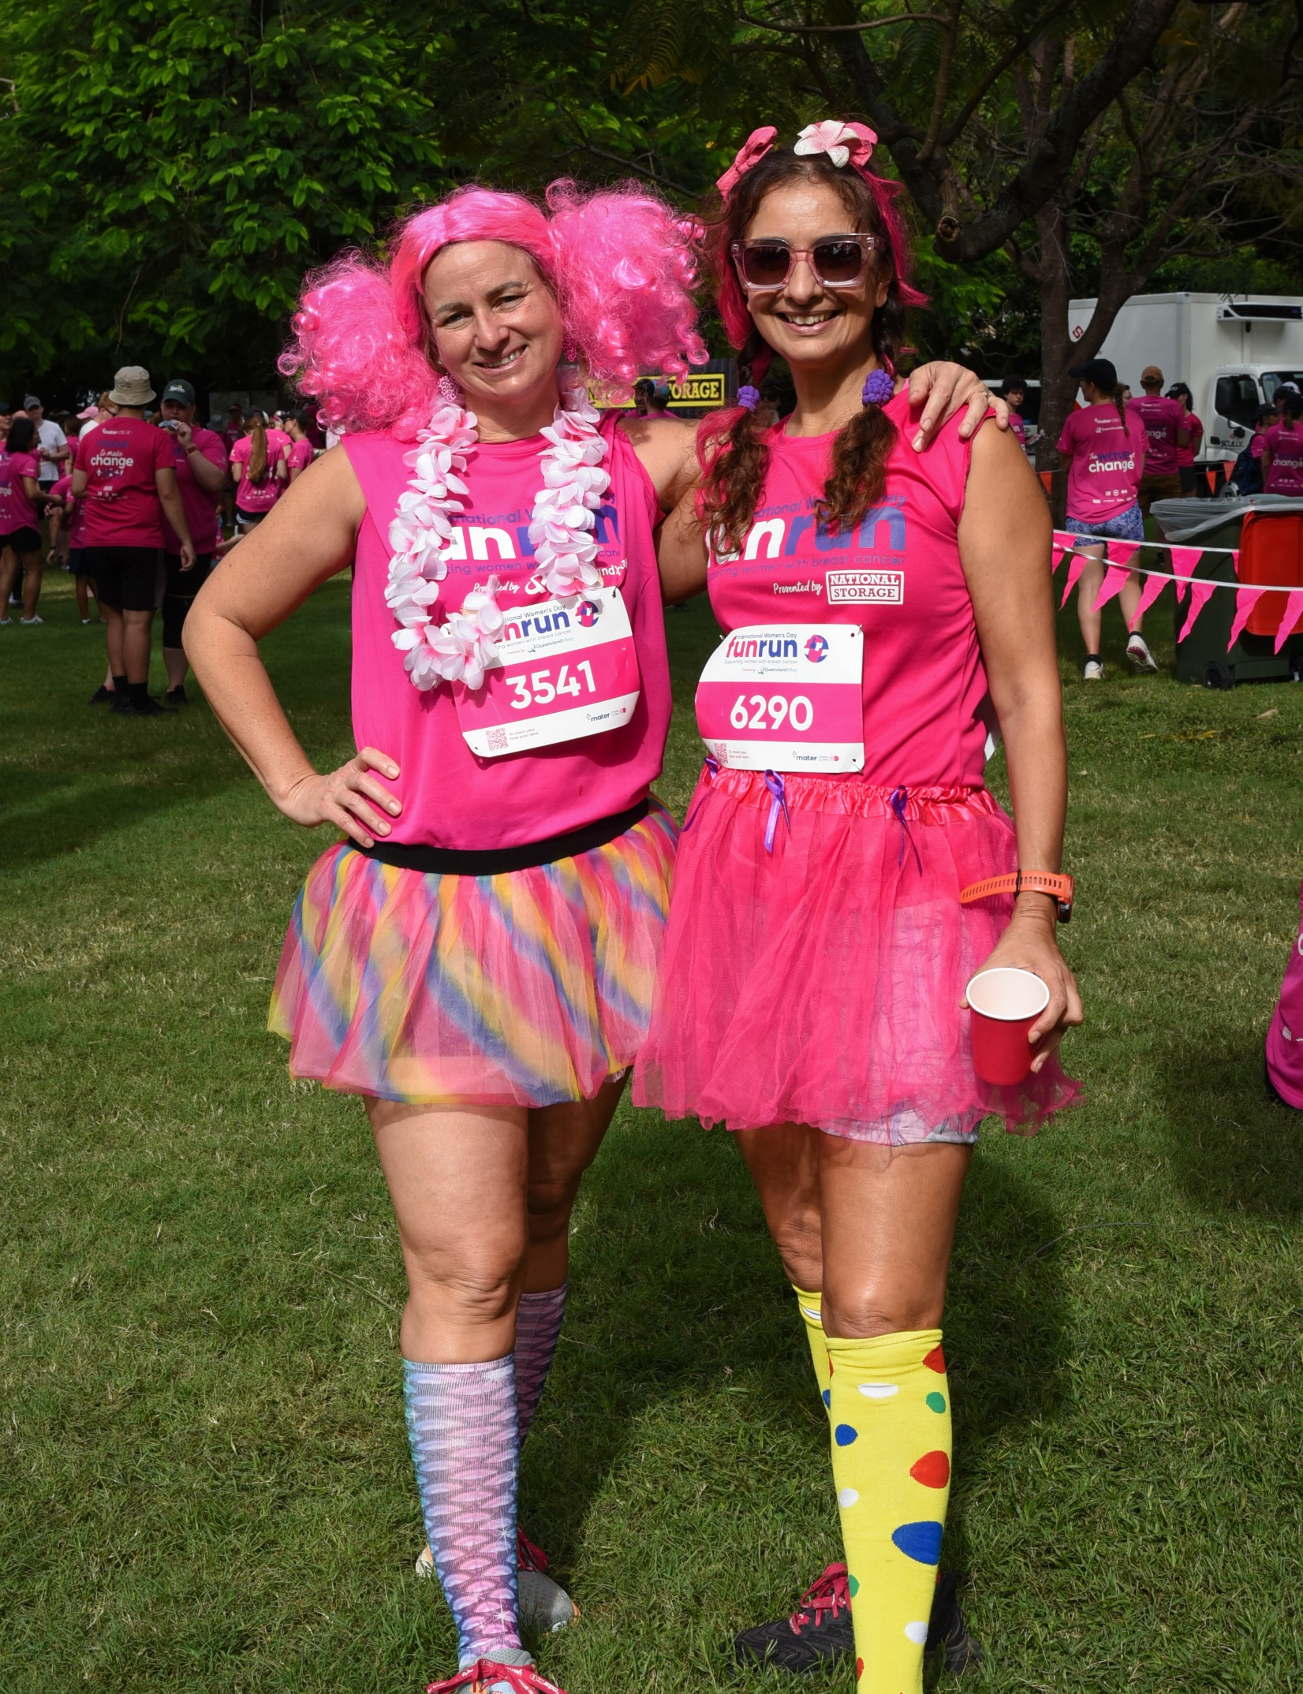
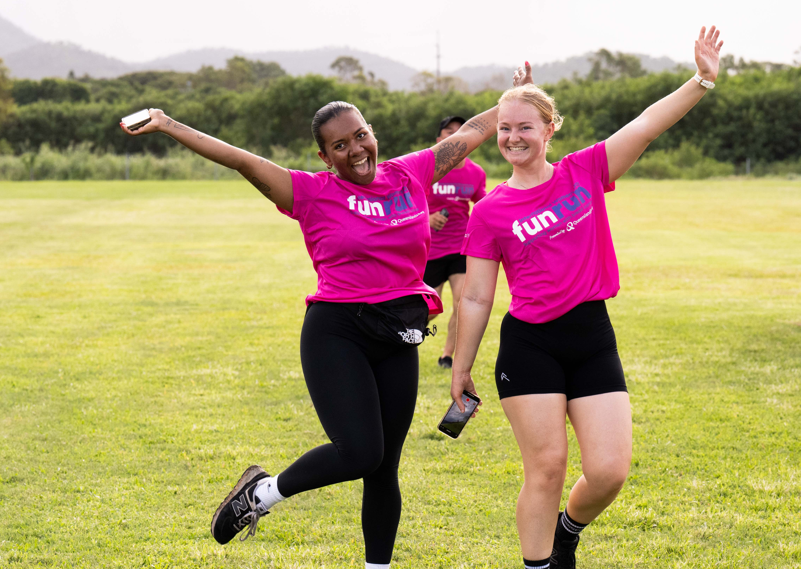
How to get involved
Join or donate to our team:
[INSERT TEAM NAME]
https://fundraise.mater.org.au/event/funrun-2026/search
Support a fundraising activity:
  [INSERT LIST OF FUNDRAISING ACTIVITIES]
Volunteer opportunities:
For more information, contact [INSERT NAME] or visit: fundraise.mater.org.au/event/funrun-2026/volunteer
Notes:
Join our school team today with our name as: [TEAM NAME]
We will be running the following fundraising activities and we encourage all students to support in the activities: [LIST A FEW ACTIVITIES]
Mater Foundation is also offering volunteer opportunities. If you would like to volunteer on the day, please contact your school’s representative [OR INSERT NAME].

Slide 6

Thank You
We look forward to seeing you in the
Sea of Pink!

